Slide 1

5-1 USING IT TO TALK ABOUT TIME
QUESTION
ANSWER
(e) What time is it?
It’s 5:00.
It’s five.
It’s five o’clock.
It’s five (o’clock) P.M.
American English
British English
12
5:00
11
1
5.00
2
10
9
3
8
4
7
5
6

Slide 2
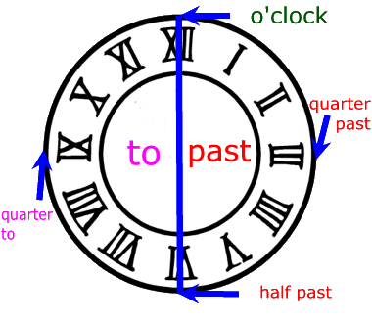
5-1 USING IT TO TALK ABOUT TIME

Slide 3
5-1 USING IT TO TALK ABOUT TIME
QUESTION
ANSWER
(e) What time is it?
It’s 7:10.
It’s seven-ten.
It’s ten past seven
12
11
1
2
10
9
3
8
4
7
5
6

Slide 4
5-1 USING IT TO TALK ABOUT TIME
QUESTION
ANSWER
(e) What time is it?
It’s 7:15.
It’s seven-fifteen.
It’s a quarter past seven
12
11
1
2
10
9
3
8
4
7
5
6

Slide 5
5-1 USING IT TO TALK ABOUT TIME
QUESTION
ANSWER
(e) What time is it?
It’s 7:30.
It’s seven-thirty.
It’s half past seven
12
11
1
2
10
9
3
8
4
7
5
6

Slide 6
5-1 USING IT TO TALK ABOUT TIME
QUESTION
ANSWER
(e) What time is it?
It’s 7:45.
It’s seven-fourty five.
It’s a quarter to eight
12
11
1
2
10
9
3
8
4
7
5
6

Slide 7
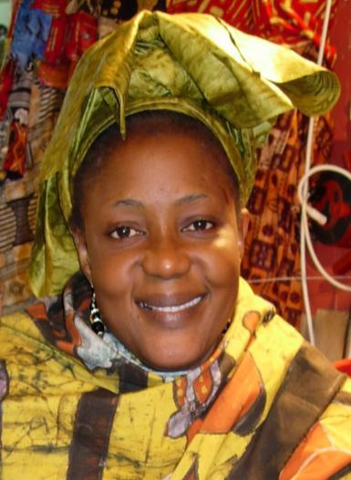

5-1 Let’s Practice
It´s 3:30 or
It´s three-thirty
What time
is it
_______________?
12
11
1
2
10
9
3
8
4
7
5
6

Slide 8
5-1 Let’s Practice
What time
is it
_______________?
It´s 2:55
12
11
1
2
10
9
3
8
4
7
5
6

Slide 9
5-1 Let’s Practice
What time
is it
_______________?
It´s 12:25
12
11
1
2
10
9
3
8
4
7
5
6

Slide 10
5-1 Let’s Practice
What time
is it
_______________?
It´s ten o´clock
12
11
1
2
10
9
3
8
4
7
5
6

Slide 11
5-1 Let’s Practice
What time
is it
_______________?
It´s 7:35
12
11
1
2
10
9
3
8
4
7
5
6

Slide 12
5-1 Let’s Practice
What time
is it
_______________?
12
11
1
2
10
9
3
8
4
7
5
6

Slide 13
5-1 Let’s Practice
What time
is it
_______________?
12
11
1
2
10
9
3
8
4
7
5
6

Slide 14
What time
is it
_______________?
Afternoon

Slide 15
What time
is it
_______________?
Evening

Slide 16
What time
is it
_______________?
Night

